Slide 1
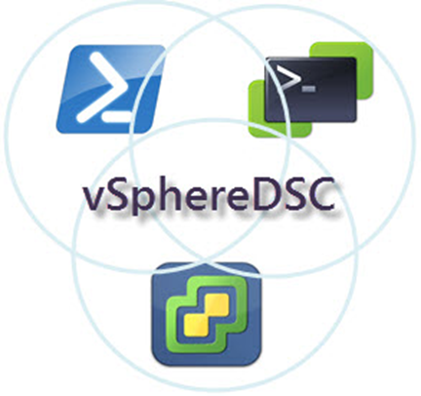
DSC and vSphere
The Path to a DSC Resource Module

Slide 2
Agenda
A bit of history
Concept
Choices
Bumps on the Road
Birdseye
Close Up
The Way Ahead

Slide 3
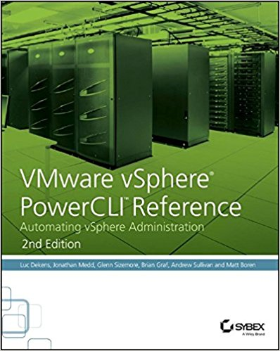


Bio
Luc Dekens
Belgium (the Flemish part)
Virtualisation ➔ PowerShell/PowerCLI ➔ SDDC ➔ DSC
PowerCLI Reference 1 ed & 2 ed
VMTN Community LucD
Blog LucD.info
Twitter @LucD22

Slide 4

History
SDDC: one way is DSC
PowerCLI is my tool of choice
PowerShell
VMworld 2015
First public repo GitHub
PowerShell v5 (Feb 2016)
Hackathons VMworld 2016
PowerCLI v6.5R1 (Nov 2016)

Slide 5
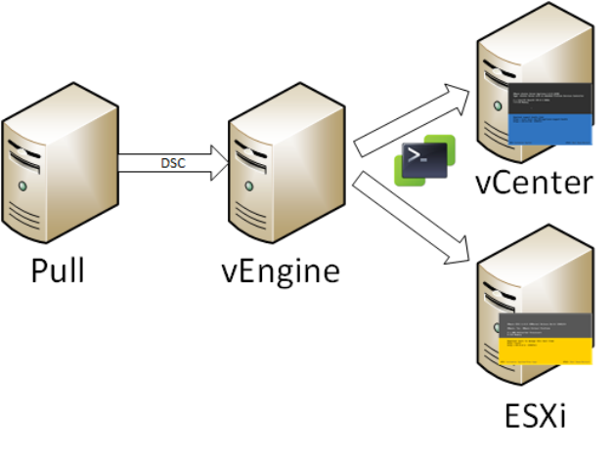
Concept
vSphere Servers: closed box
vCenter (VCSA)
ESXi node
vEngine
LCM
PowerCLI
Connects

Slide 6
Choices
vEngine currently a Windows (W2K16) box
Secure environment (AllSigned)
Classes
Inheritance
MOF
All vSphere code uses API directly
Faster
Covers features not available in PowerCLI cmdlets (80%-20% rule)

Slide 7

Pitfalls 1
Pre PowerCLI 6.5R1
PSSnapins
No autoload available
Security
Certificates
Code signing
Credential encryption
Using module & RequiredAssemblies
LCM fails at MOF generation
PowerCLI code in “helper” file (again!)

Slide 8
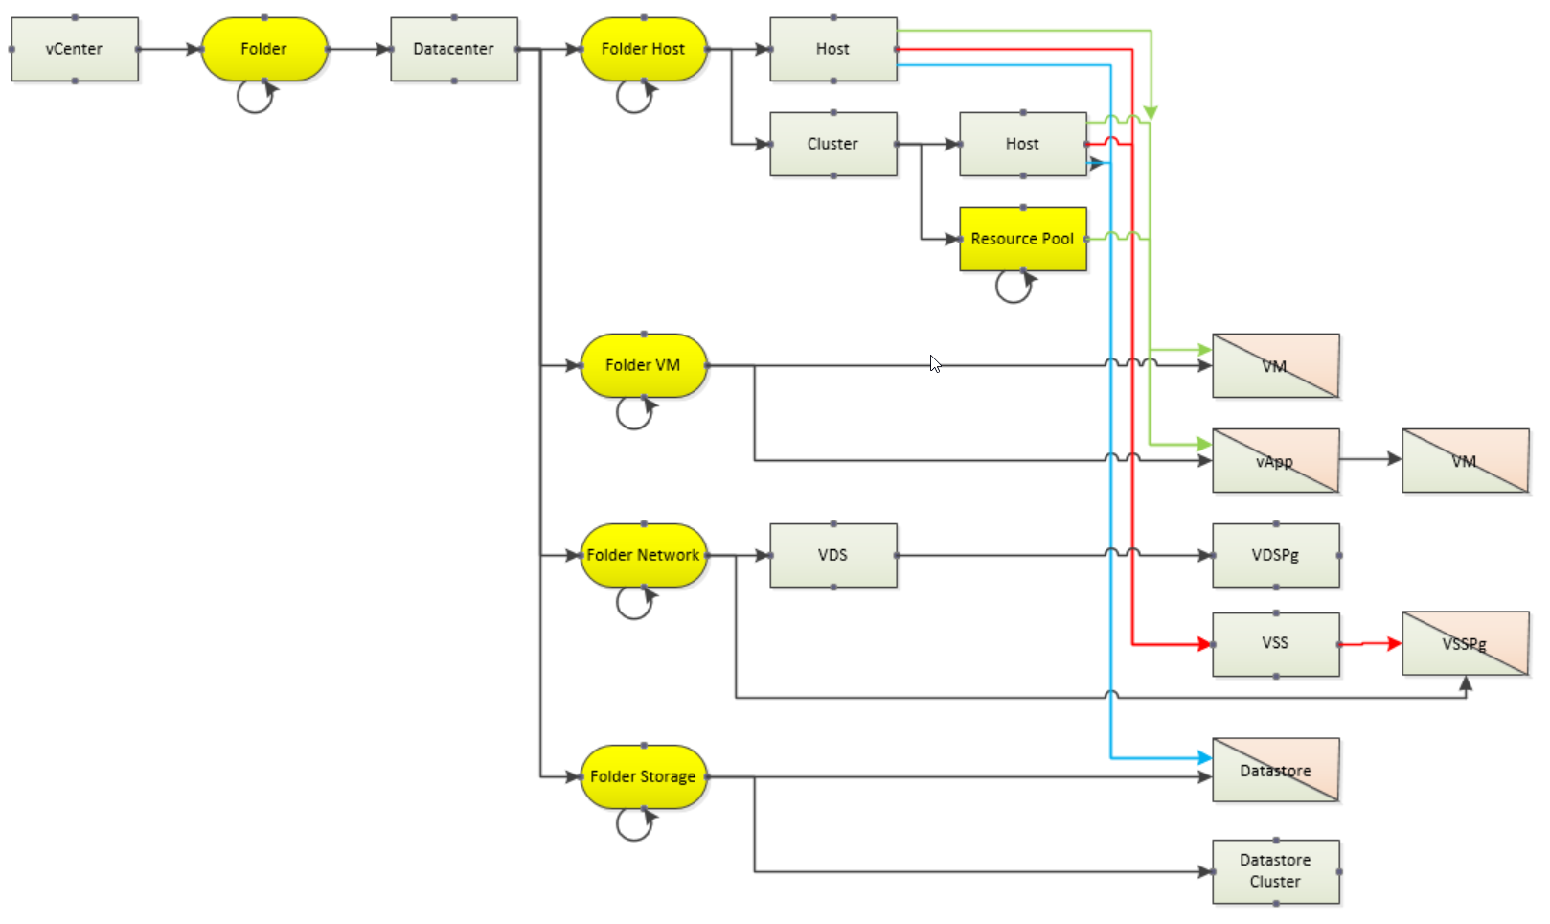
Pitfalls 2
(vSphere -contains legacy) –and (vSphere.design –isnot [logical])

Slide 9
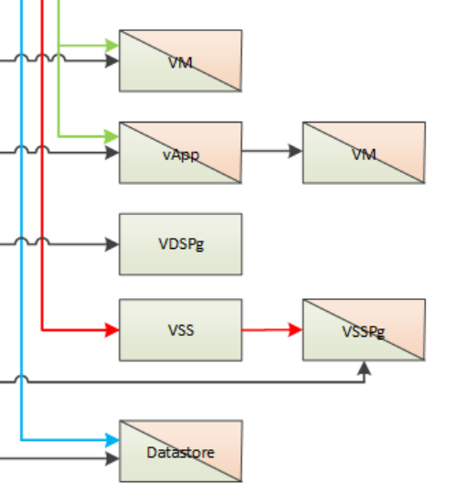
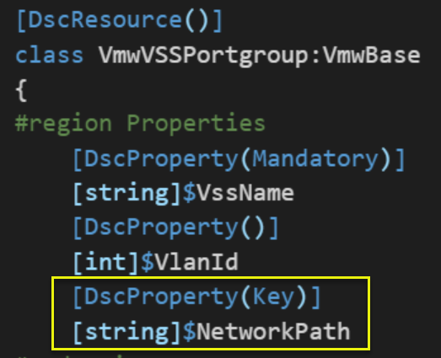
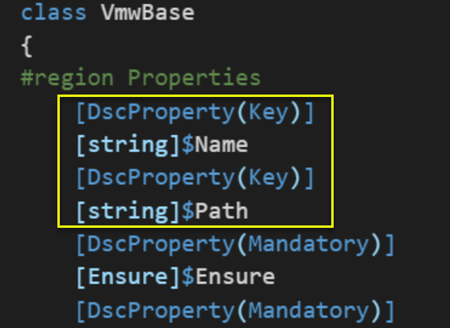
Pitfalls 3
How to uniquely address a vSphere object
Common = VmwBase class
Name (e.g. Folder1)
Path (e.g. /DC1/Folder1)
Several objects have more than 1 path

Slide 10
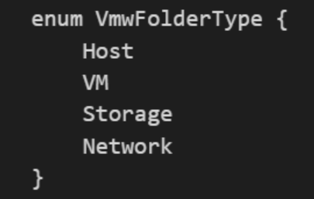
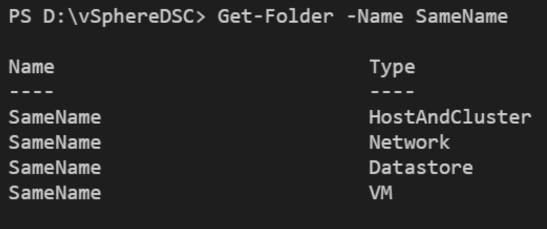
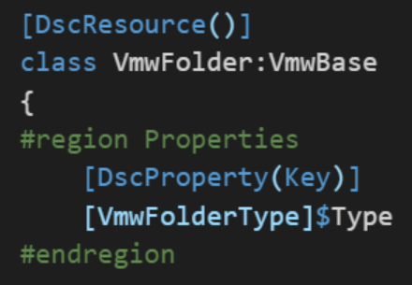
Pitfalls 4
Folder with identical Name
FolderType

Slide 11
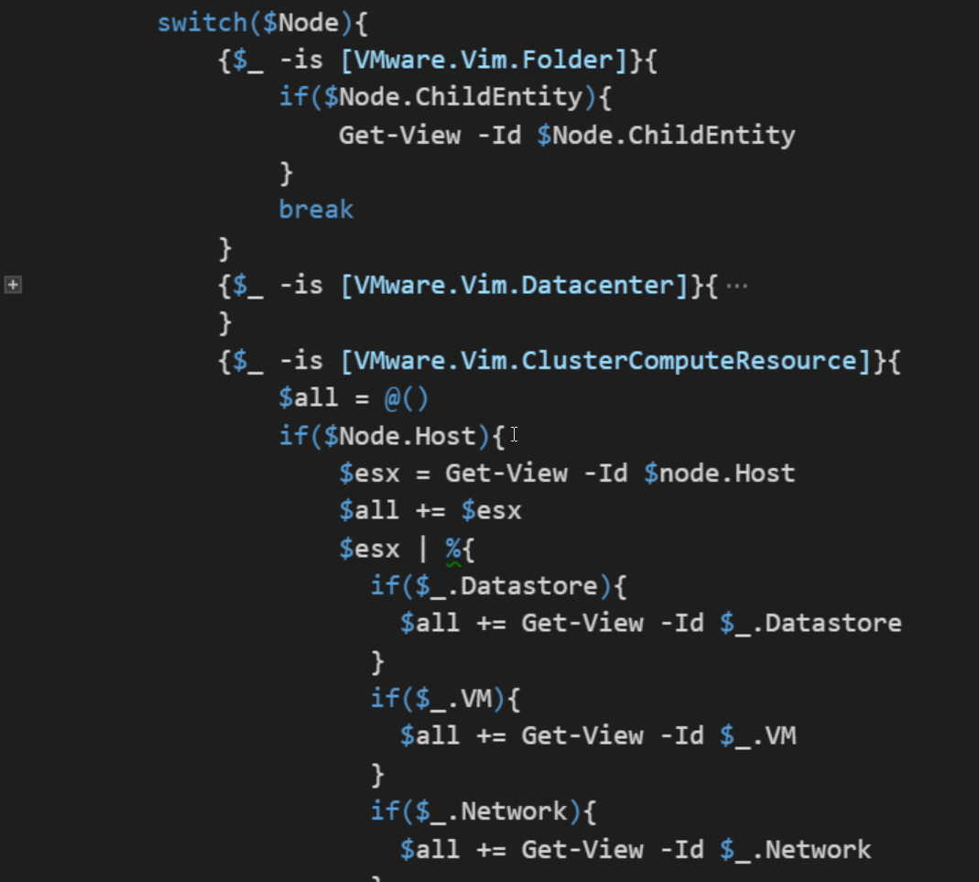
Pitfall 5
Traversing the vSphere tree
Legacy structure
“Parent” property absent for some

Slide 12
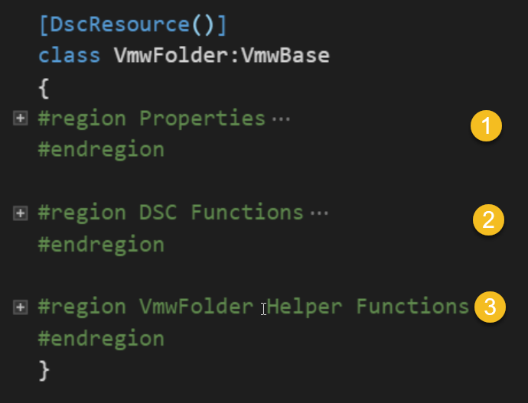
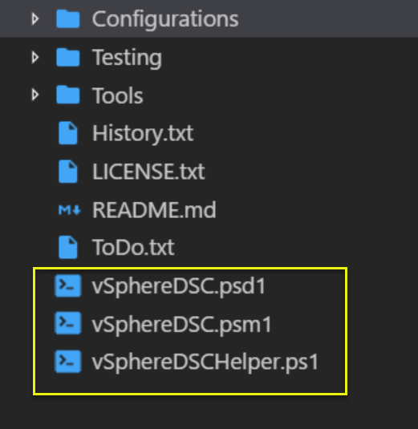
Birdseye 1
Simple, “clean” structure
Each resource, same layout

Slide 13
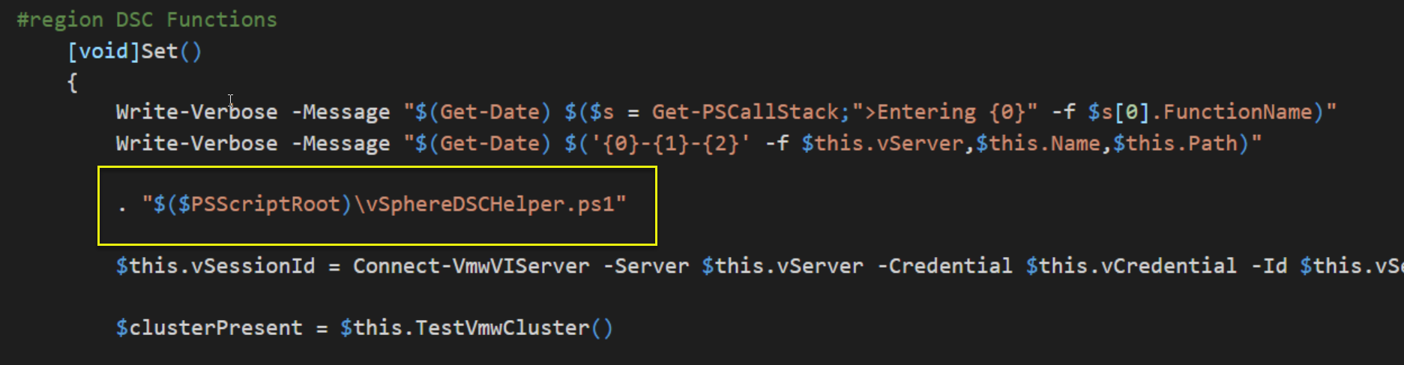
Birdseye 2
Separate PS and PowerCLI code (Vmware.Vim types!)
All PowerCLI code in vSphereDSCHelper.ps1
Dot-source
Not elegant, but it works!

Slide 14
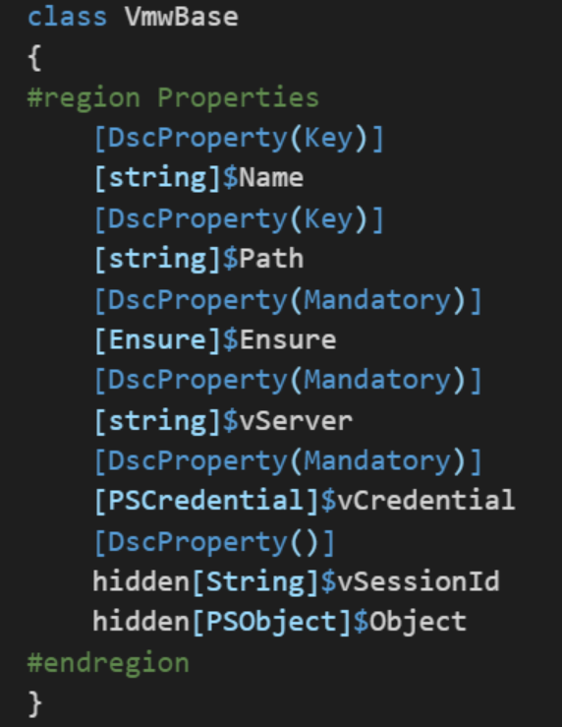
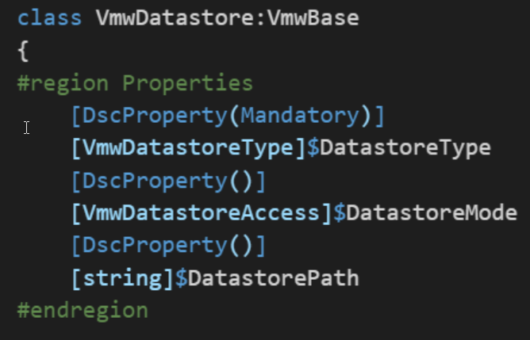
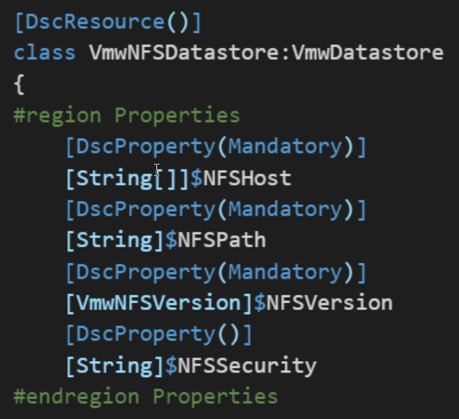
Details 1
Properties
Classes + inheritance

Slide 15
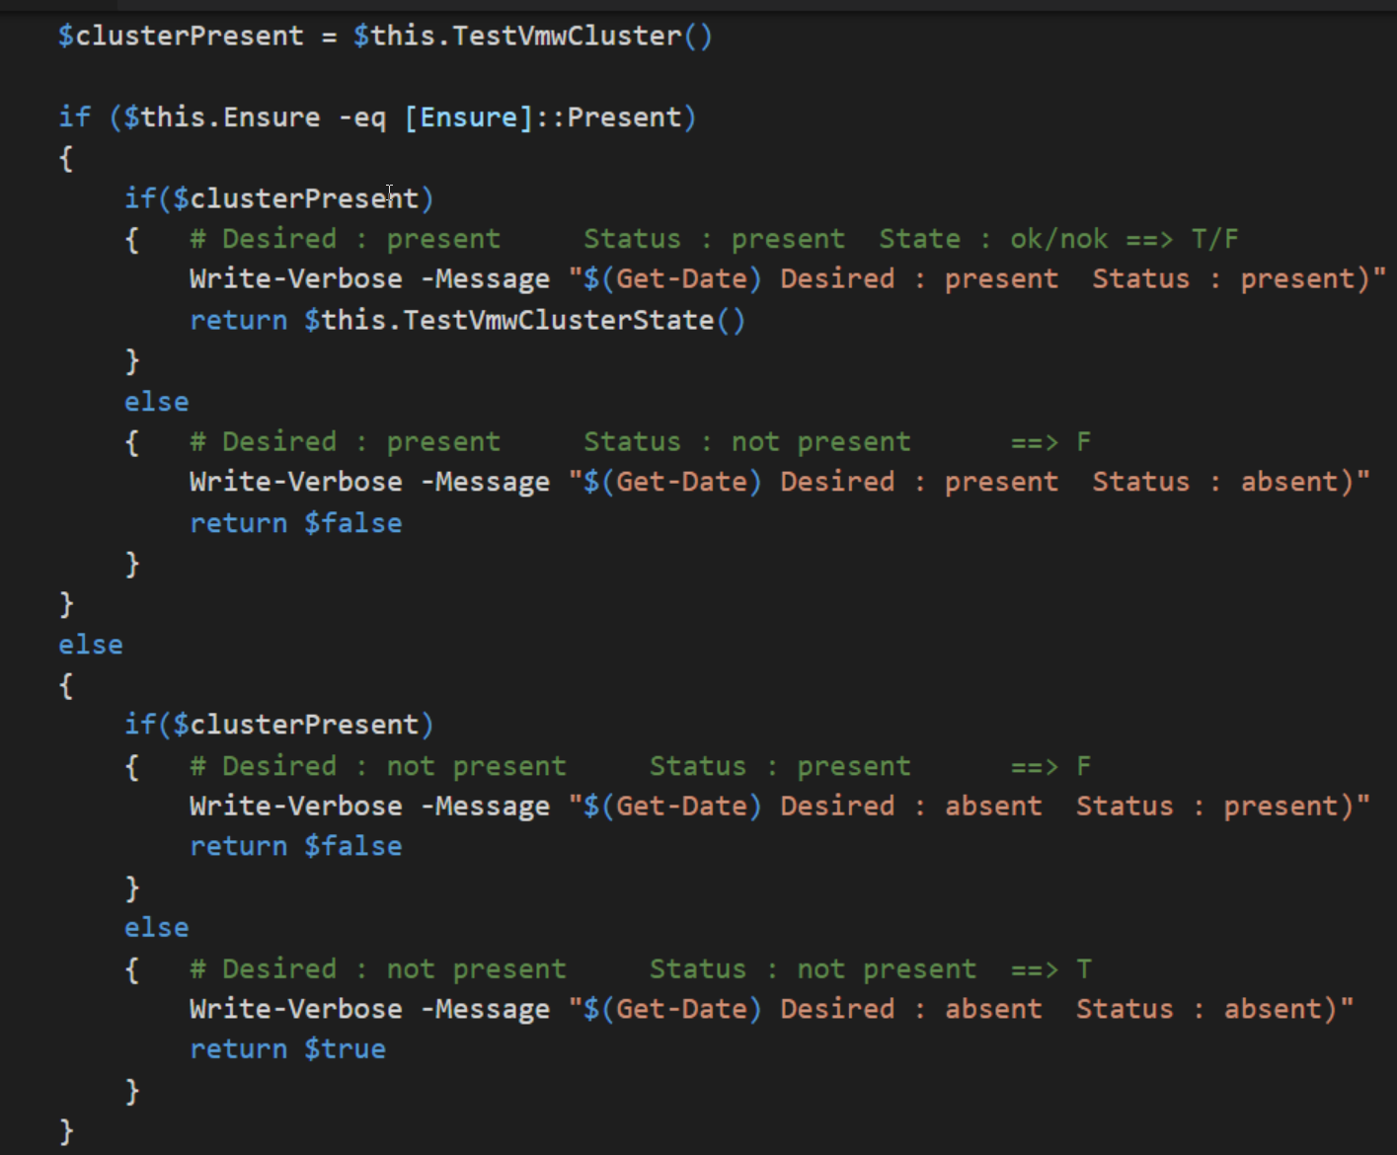
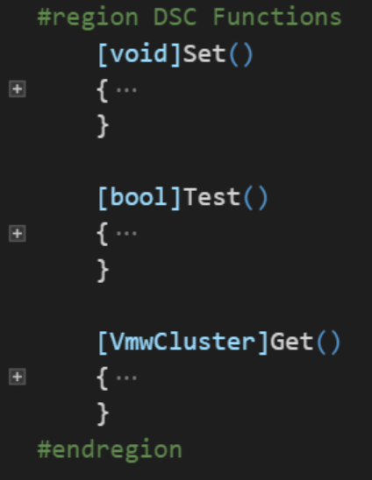
Details 2
Test/Set/Get: only the logic
No PowerCLI!
State of an Object!

Slide 16
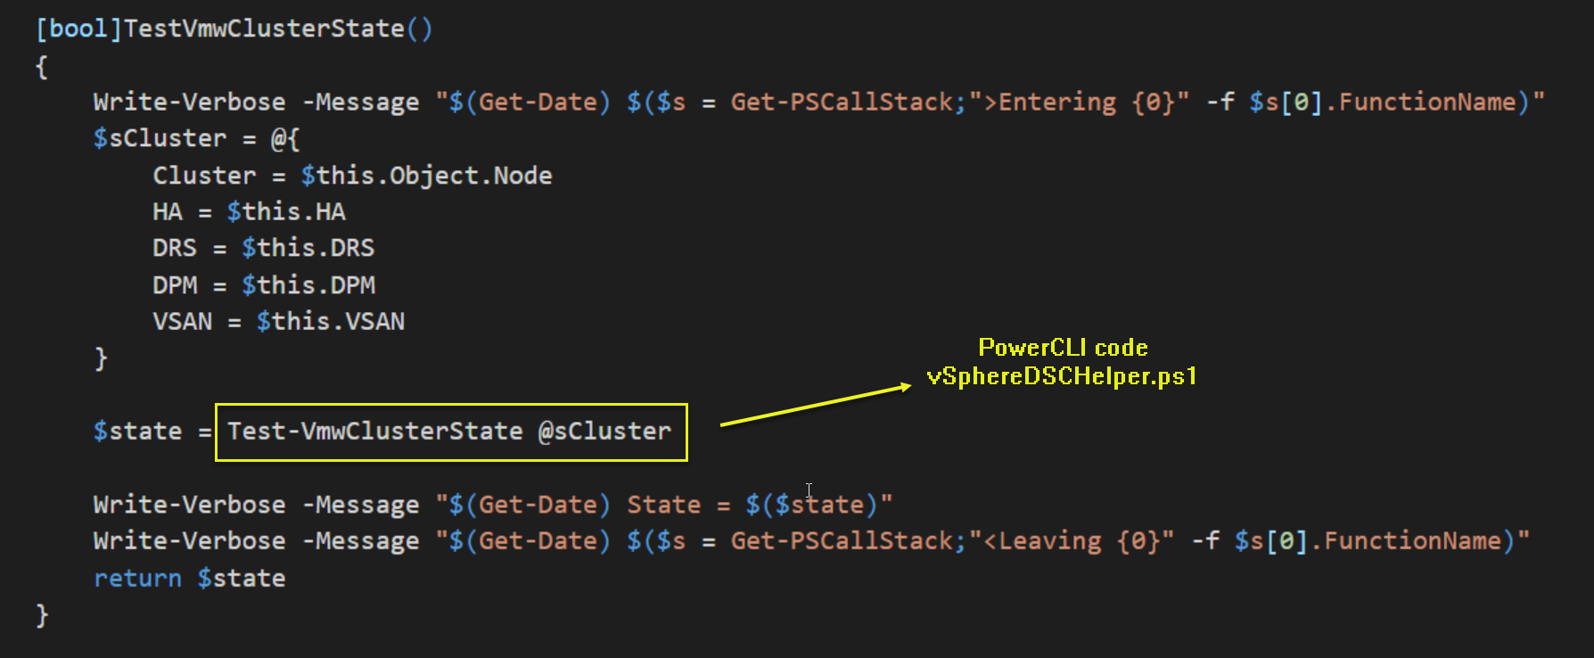
Details 3
Logic beyond DSC functionality. Helper functions
“Knows” about vSphere

Slide 17
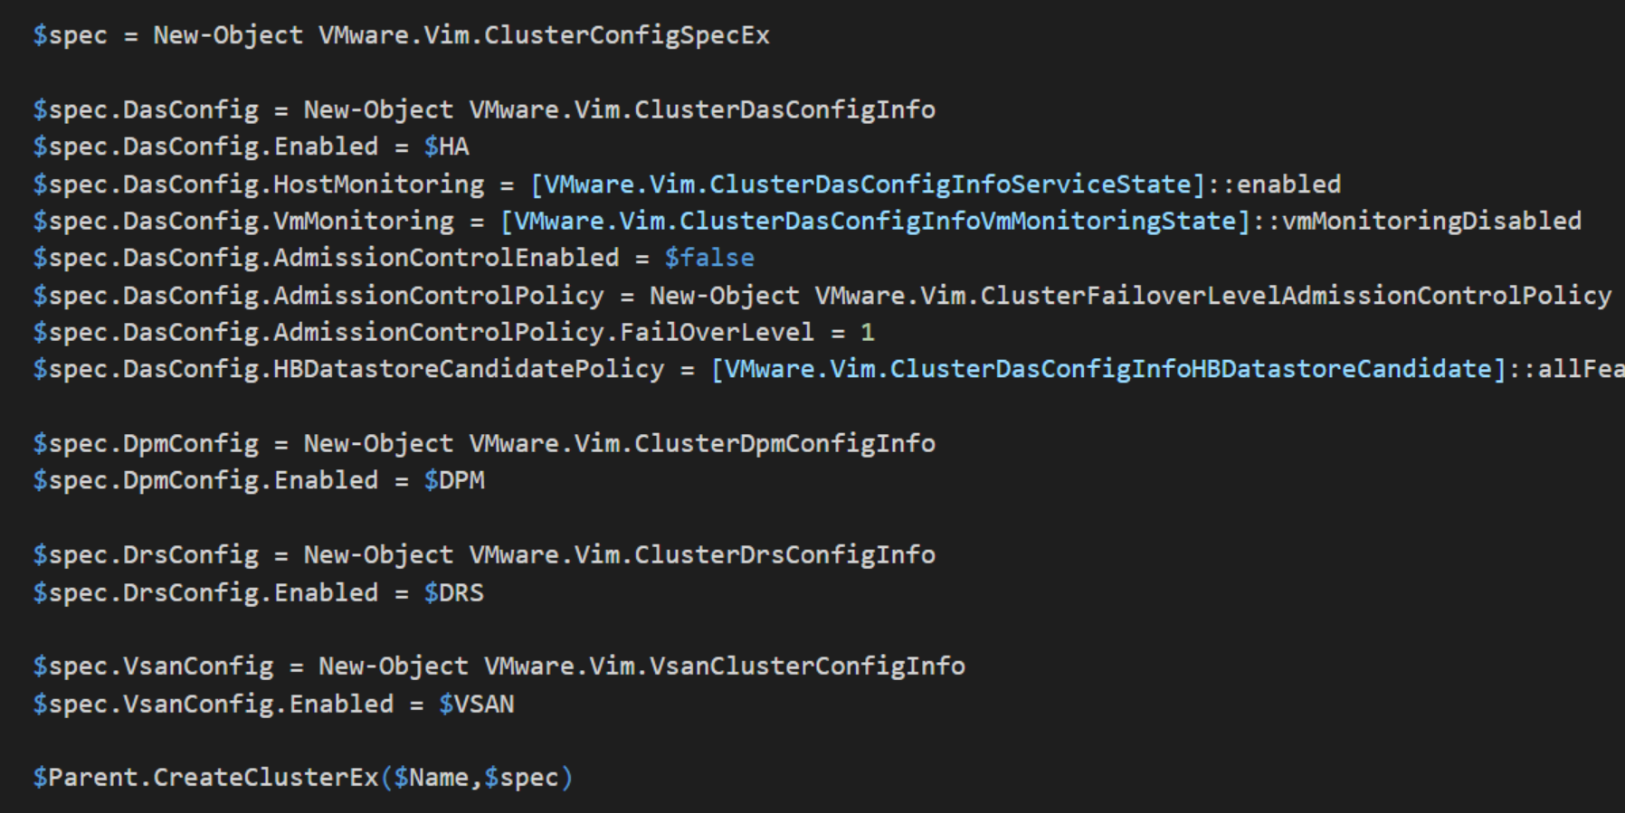
Details 4
PowerCLI code in vSphereDSCHelper.ps1

Slide 18
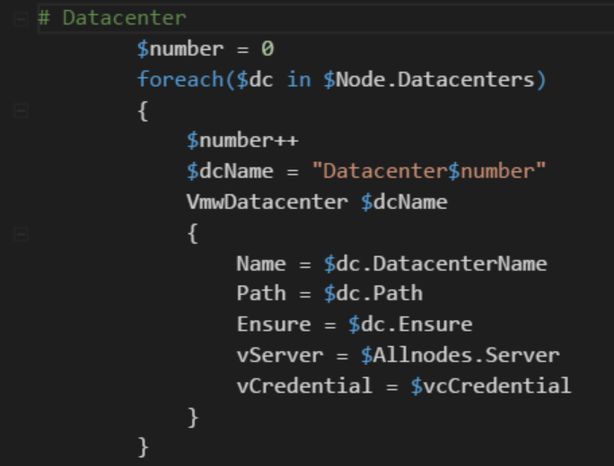
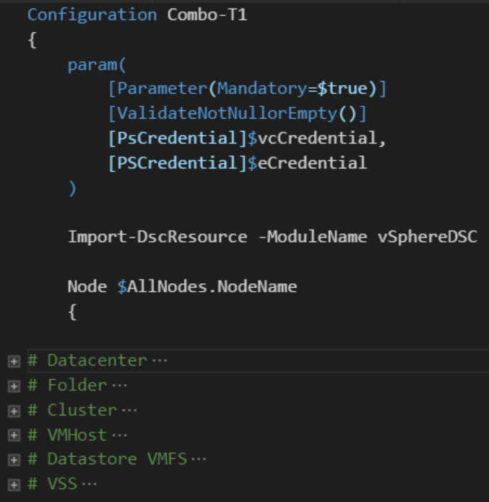
Details 5
Configuration file
Separate What from Where
Fixed Structural lines

Slide 19
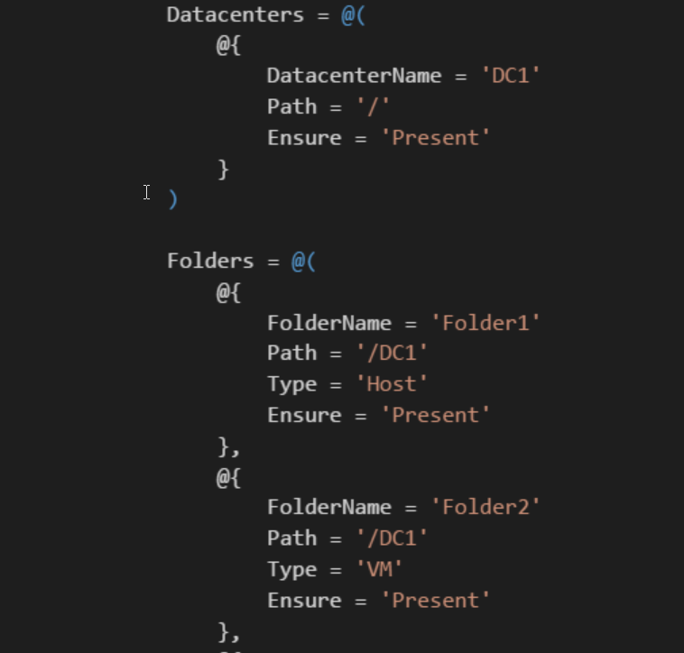
Details 6
ConfigurationData in .psd1 file
No variables
Use Configuration parameters
No Enum
Use String
Source control!
Txt file ➔ diff

Slide 20
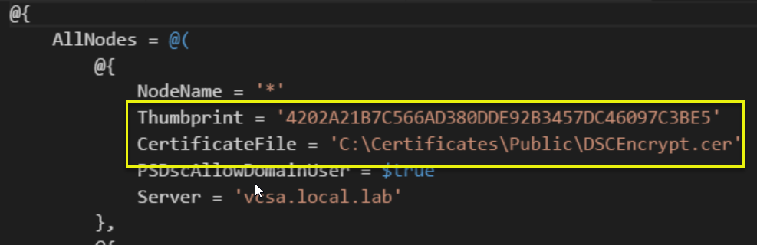
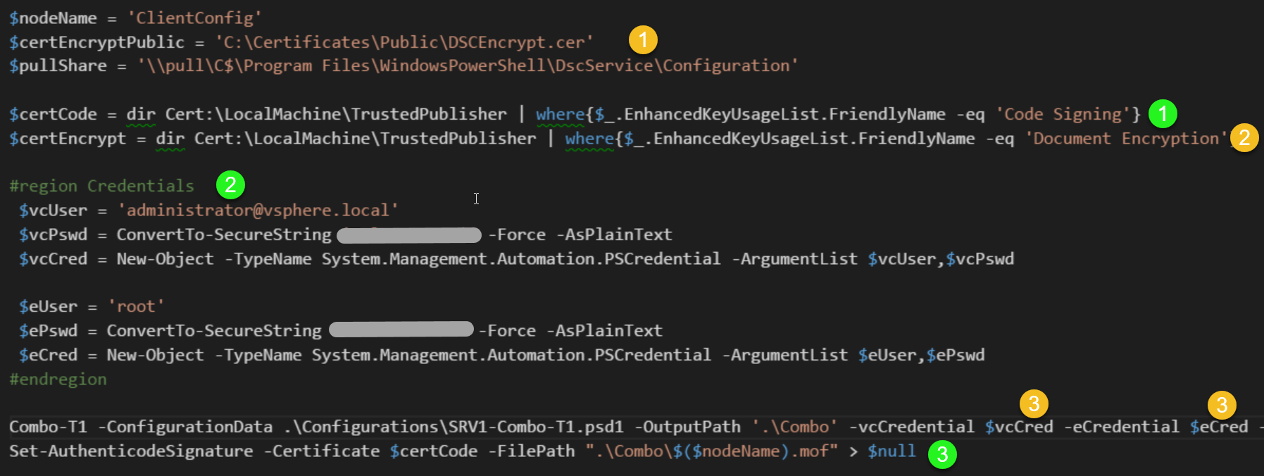
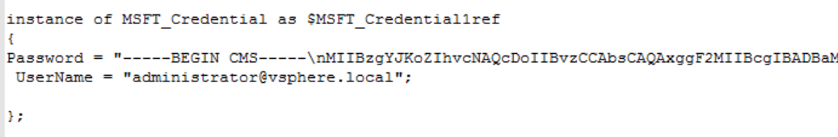
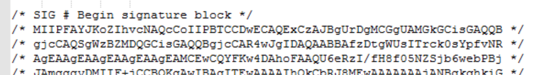
Detail 7
Security
Configuration signed
Credentials encrypted

Slide 21
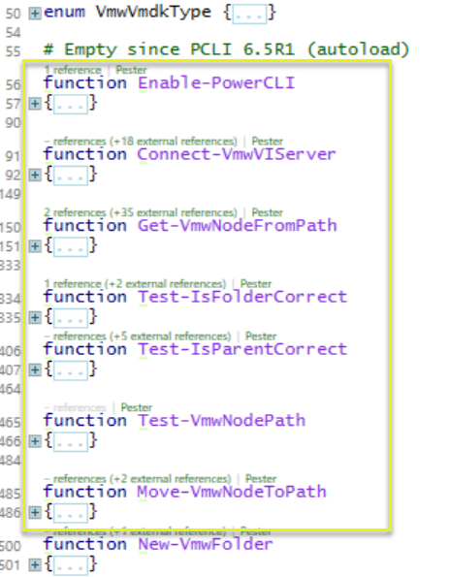
Detail 8
Basic Helper functions
In vSphereDSCHelper.ps1
Functionality
vSphere server connect
Locate node (test for node + locate parent for new node)
Test if folder is correct
Test if parent is correct
Move a node to a location

Slide 22
Demo
Combined resources
Populate VCSA

Slide 23
Future
Add more resources
Improve testing (Pester)
Unit: quite simple
Integration: requires Greenfield/sandbox
Better ideas welcome
Provide (easy) test environment setup
I used Vagrant
DSC based?
Add Tooling (remember DSC is a framework)
Environment ➔ Configuration files

Slide 24
Join in!
BitBucket ➔ Github
Creating a new resource is simple
Blogpost cookbook style following
Logic is copy/paste + minor edit
Helper functions require PowerCLI
Prototyping with PowerCLI cmdlets

Slide 25
Template structure
vSphereDSC.psm1
Copy an existing resource
Define class properties (Key & Mandatory!)
Review Get-Set-Test ➔ minimal change
vSphereDSCHelper.ps1
Same set of functions
New/Remove
Test/TestState/SetState
Proto-typing: PowerCLI cmdlets
Production: API methods

Slide 26
Q&A

